Slide 1
Stress, Lifestyle, and Health
Chapter 14

Slide 2
Agenda
What is Stress?
The Stress Response
Stress and Illness
Regulation of Stress
Positive Psychology

Slide 3

What do you think a stressor is?
Notes:
stress -a process whereby an individual perceives and responds to events that they appraise as overwhelming or threatening to their well-being
stressors - threatening events

Slide 4
What are some examples of each of these stressors?
Traumatic events
Life changes
Daily hassles
Occupation-related stressors

Slide 5
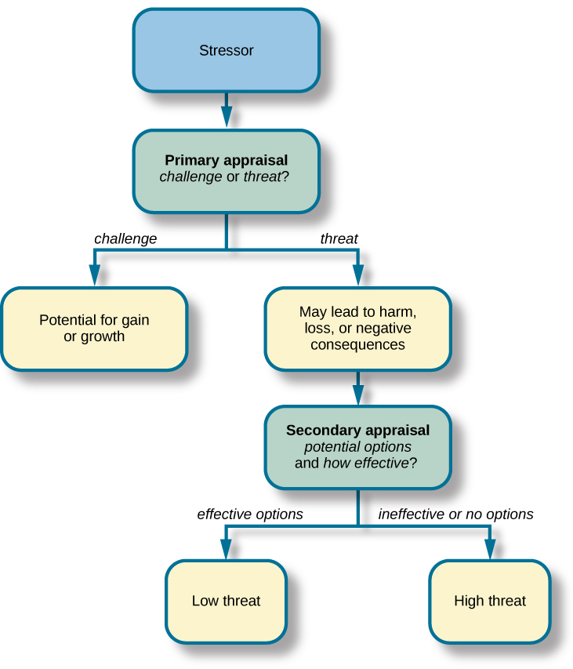
Appraising a Threat
Notes:
primary appraisal involves judgment about the degree of potential harm or threat to well-being that a stressor might entail.
secondary appraisal: judgment of the options available to cope with a stressor, as well as perceptions of how effective such options will be

Slide 6
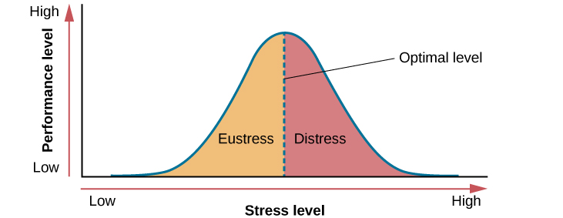
Good and Bad Stress
Notes:
eustress (from the Greek eu = “good”), is a good kind of stress associated with positive feelings, optimal health, and performance.
Distress - when stress exceeds this optimal level, it is no longer a positive force—it becomes excessive and debilitating,

Slide 7
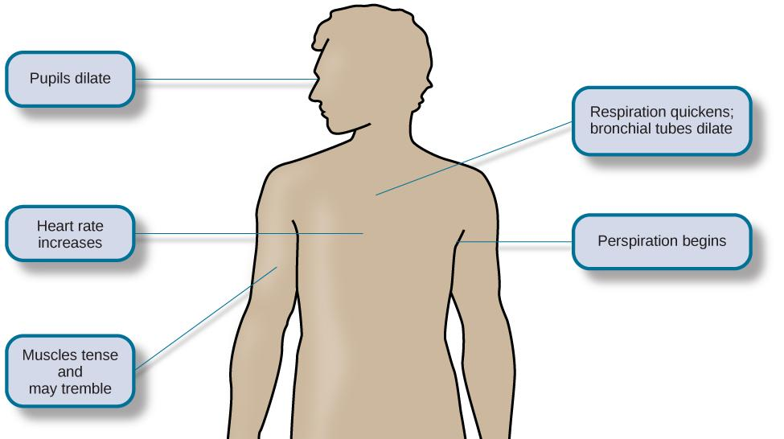
Fight or Flight Response
Notes:
Originally proposed by Walter Cannon

Slide 8
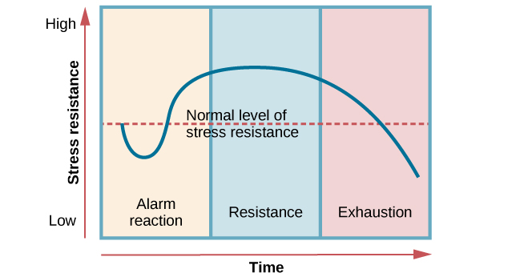
Selye & The General Adaption Syndrome
Notes:
Alarm reaction describes the body’s immediate reaction upon facing a threatening situation or emergency,
stage of resistance, the initial shock of alarm reaction has worn off and the body has adapted to the stressor.
stage of exhaustion-the person is no longer able to adapt to the stressor: the body’s ability to resist becomes depleted as physical wear takes its toll on the body’s tissues and organs.
-doesn’t account for individual differences

Slide 9
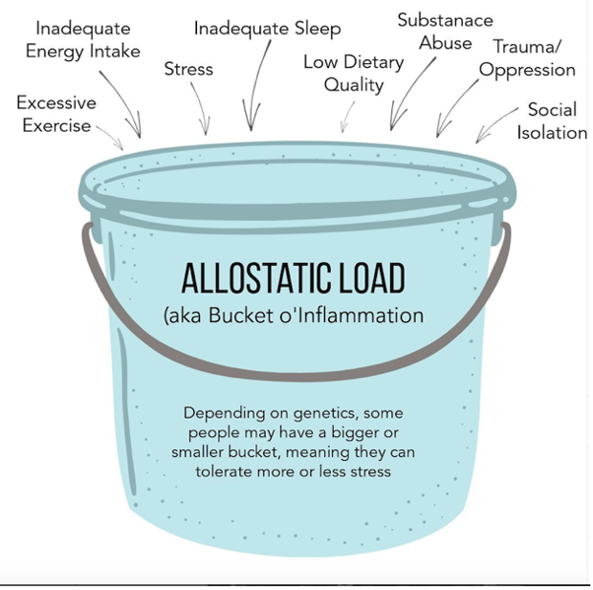
How much stress is too much?
It depends on your capacity to carry stress

Slide 10
The STRESS RESPONSE

Slide 11
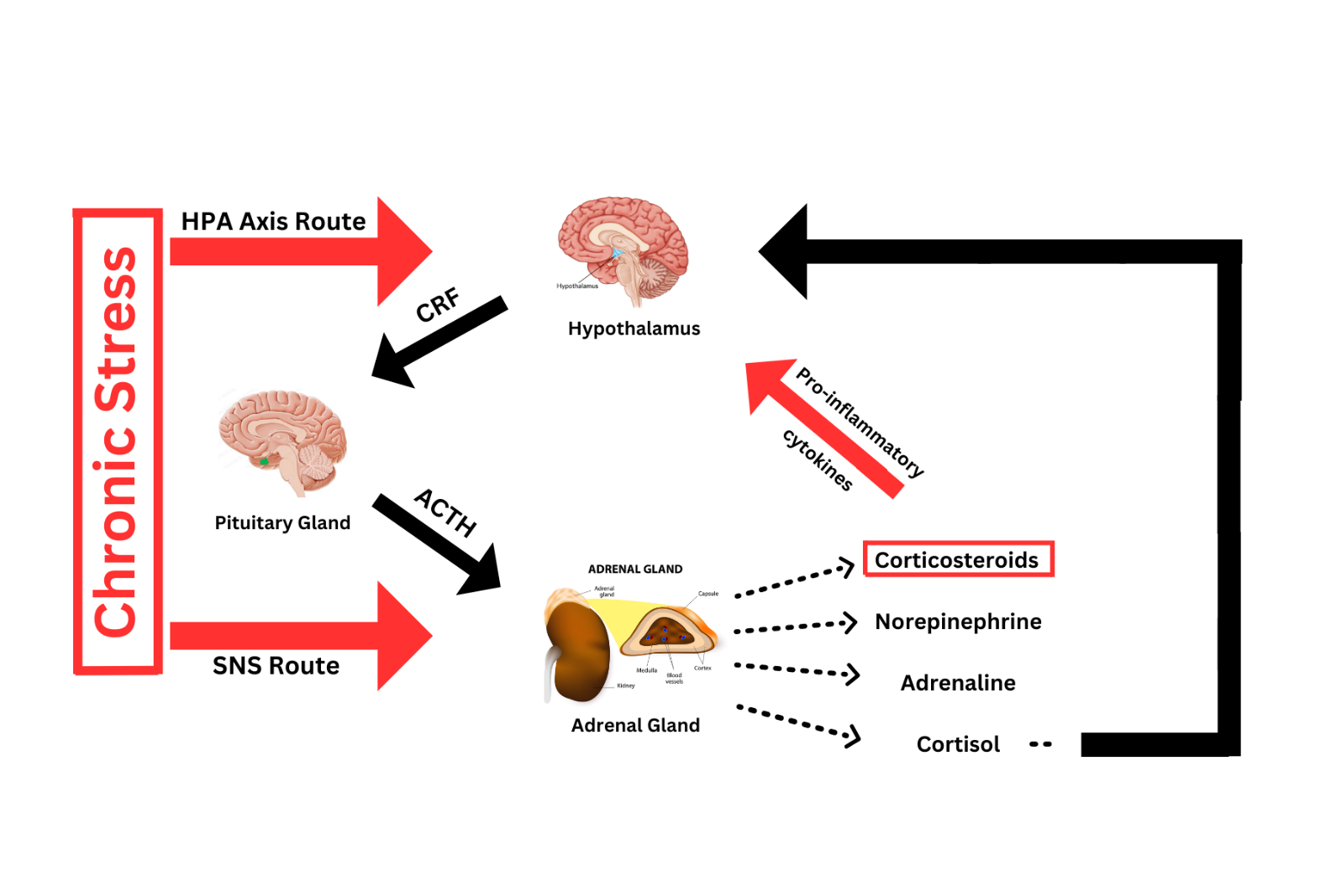
The Physiology of Stress
Step 1: Hypothalamus releases CRF at a higher-than-usual rate
Note: CRF = corticotropin-releasing factor
Notes:
When a person undergoes stress for an extended period of time, the floodgates in the hypothalamus open, and a hormone known as the corticotropin-releasing factor (CRF) is produced at higher-than usual rates (Dai et al., 2020). CRF then travels through the blood to the pituitary gland, where the adrenocorticotropic hormone (ACTH) is released into the blood stream. ACTH travels to the adrenal cortex. This pathway is known as the hypothalamus-pituitary-adrenal (HPA) axis. While this axis is being almost constantly activated, the adrenal gland is also being stimulated by the sympathetic nervous system (SNS), as the body tries to induce a fight-or-flight response to escape the stress it is experiencing. When the adrenal gland is stimulated, it releases a variety of hormones, including corticosteroids, norepinephrine, adrenaline, and cortisol. In a healthy system, cortisol feeds back to glucocorticoid receptors in the hypothalamus, stopping the release of CRF. Research has found that in situations of chronic stress, the glucocorticoid receptors become desensitized to cortisol, so the hypothalamus continues to release CRF (Tausk, 2023). At the same time, the corticosteroids that are being mass-produced as a result of chronic stress alter the production of cytokines. Reiche et al. (2004) stated that when over-produced during chronic stress, corticosteroids can alter the production of pro-inflammatory cytokines. Tausk (2023) reported that these pro-inflammatory cytokines released into the bloodstream can pass through the blood-brain barrier and activate the hypothalamus, further perpetuating the cycle through the HPA axis. This process is illustrated in Figure 2. Being stuck in this cycle can diminish the function of the prefrontal cortex and hippocampus, and lead to a mass production of stress hormones (Dai et al., 2020).

Slide 12
The Physiology of Stress
Step 2: Pituitary gland is hit with CRF, triggering it to release ACTH
Note: ACTH = adrenocorticotropic hormone
Notes:
When a person undergoes stress for an extended period of time, the floodgates in the hypothalamus open, and a hormone known as the corticotropin-releasing factor (CRF) is produced at higher-than usual rates (Dai et al., 2020). CRF then travels through the blood to the pituitary gland, where the adrenocorticotropic hormone (ACTH) is released into the blood stream. ACTH travels to the adrenal cortex. This pathway is known as the hypothalamus-pituitary-adrenal (HPA) axis. While this axis is being almost constantly activated, the adrenal gland is also being stimulated by the sympathetic nervous system (SNS), as the body tries to induce a fight-or-flight response to escape the stress it is experiencing. When the adrenal gland is stimulated, it releases a variety of hormones, including corticosteroids, norepinephrine, adrenaline, and cortisol. In a healthy system, cortisol feeds back to glucocorticoid receptors in the hypothalamus, stopping the release of CRF. Research has found that in situations of chronic stress, the glucocorticoid receptors become desensitized to cortisol, so the hypothalamus continues to release CRF (Tausk, 2023). At the same time, the corticosteroids that are being mass-produced as a result of chronic stress alter the production of cytokines. Reiche et al. (2004) stated that when over-produced during chronic stress, corticosteroids can alter the production of pro-inflammatory cytokines. Tausk (2023) reported that these pro-inflammatory cytokines released into the bloodstream can pass through the blood-brain barrier and activate the hypothalamus, further perpetuating the cycle through the HPA axis. This process is illustrated in Figure 2. Being stuck in this cycle can diminish the function of the prefrontal cortex and hippocampus, and lead to a mass production of stress hormones (Dai et al., 2020).

Slide 13
The Physiology of Stress
Step 3: Adrenal gland is triggered by both the HPA axis and the SNS, at the same time
Note: HPA axis = hypothalamic-pituitary-adrenal axis; SNS = sympathetic nervous system
Notes:
When a person undergoes stress for an extended period of time, the floodgates in the hypothalamus open, and a hormone known as the corticotropin-releasing factor (CRF) is produced at higher-than usual rates (Dai et al., 2020). CRF then travels through the blood to the pituitary gland, where the adrenocorticotropic hormone (ACTH) is released into the blood stream. ACTH travels to the adrenal cortex. This pathway is known as the hypothalamus-pituitary-adrenal (HPA) axis. While this axis is being almost constantly activated, the adrenal gland is also being stimulated by the sympathetic nervous system (SNS), as the body tries to induce a fight-or-flight response to escape the stress it is experiencing. When the adrenal gland is stimulated, it releases a variety of hormones, including corticosteroids, norepinephrine, adrenaline, and cortisol. In a healthy system, cortisol feeds back to glucocorticoid receptors in the hypothalamus, stopping the release of CRF. Research has found that in situations of chronic stress, the glucocorticoid receptors become desensitized to cortisol, so the hypothalamus continues to release CRF (Tausk, 2023). At the same time, the corticosteroids that are being mass-produced as a result of chronic stress alter the production of cytokines. Reiche et al. (2004) stated that when over-produced during chronic stress, corticosteroids can alter the production of pro-inflammatory cytokines. Tausk (2023) reported that these pro-inflammatory cytokines released into the bloodstream can pass through the blood-brain barrier and activate the hypothalamus, further perpetuating the cycle through the HPA axis. This process is illustrated in Figure 2. Being stuck in this cycle can diminish the function of the prefrontal cortex and hippocampus, and lead to a mass production of stress hormones (Dai et al., 2020).

Slide 14
The Physiology of Stress
Step 4: Adrenal gland releases a bunch of hormones
Notes:
When a person undergoes stress for an extended period of time, the floodgates in the hypothalamus open, and a hormone known as the corticotropin-releasing factor (CRF) is produced at higher-than usual rates (Dai et al., 2020). CRF then travels through the blood to the pituitary gland, where the adrenocorticotropic hormone (ACTH) is released into the blood stream. ACTH travels to the adrenal cortex. This pathway is known as the hypothalamus-pituitary-adrenal (HPA) axis. While this axis is being almost constantly activated, the adrenal gland is also being stimulated by the sympathetic nervous system (SNS), as the body tries to induce a fight-or-flight response to escape the stress it is experiencing. When the adrenal gland is stimulated, it releases a variety of hormones, including corticosteroids, norepinephrine, adrenaline, and cortisol. In a healthy system, cortisol feeds back to glucocorticoid receptors in the hypothalamus, stopping the release of CRF. Research has found that in situations of chronic stress, the glucocorticoid receptors become desensitized to cortisol, so the hypothalamus continues to release CRF (Tausk, 2023). At the same time, the corticosteroids that are being mass-produced as a result of chronic stress alter the production of cytokines. Reiche et al. (2004) stated that when over-produced during chronic stress, corticosteroids can alter the production of pro-inflammatory cytokines. Tausk (2023) reported that these pro-inflammatory cytokines released into the bloodstream can pass through the blood-brain barrier and activate the hypothalamus, further perpetuating the cycle through the HPA axis. This process is illustrated in Figure 2. Being stuck in this cycle can diminish the function of the prefrontal cortex and hippocampus, and lead to a mass production of stress hormones (Dai et al., 2020).

Slide 15
The Physiology of Stress
Step 5: In a healthy system, hormones like cortisol tell the hypothalamus to stop CRF production
Notes:
When a person undergoes stress for an extended period of time, the floodgates in the hypothalamus open, and a hormone known as the corticotropin-releasing factor (CRF) is produced at higher-than usual rates (Dai et al., 2020). CRF then travels through the blood to the pituitary gland, where the adrenocorticotropic hormone (ACTH) is released into the blood stream. ACTH travels to the adrenal cortex. This pathway is known as the hypothalamus-pituitary-adrenal (HPA) axis. While this axis is being almost constantly activated, the adrenal gland is also being stimulated by the sympathetic nervous system (SNS), as the body tries to induce a fight-or-flight response to escape the stress it is experiencing. When the adrenal gland is stimulated, it releases a variety of hormones, including corticosteroids, norepinephrine, adrenaline, and cortisol. In a healthy system, cortisol feeds back to glucocorticoid receptors in the hypothalamus, stopping the release of CRF. Research has found that in situations of chronic stress, the glucocorticoid receptors become desensitized to cortisol, so the hypothalamus continues to release CRF (Tausk, 2023). At the same time, the corticosteroids that are being mass-produced as a result of chronic stress alter the production of cytokines. Reiche et al. (2004) stated that when over-produced during chronic stress, corticosteroids can alter the production of pro-inflammatory cytokines. Tausk (2023) reported that these pro-inflammatory cytokines released into the bloodstream can pass through the blood-brain barrier and activate the hypothalamus, further perpetuating the cycle through the HPA axis. This process is illustrated in Figure 2. Being stuck in this cycle can diminish the function of the prefrontal cortex and hippocampus, and lead to a mass production of stress hormones (Dai et al., 2020).

Slide 16
The Physiology of Stress
Step 5b: In a chronically stressed system, hypothalamus desensitizes to cortisol, while corticosteroids mass produce pro-inflammatory cytokines (which can also activate hypothalamus)
Note: cytokines = potent signaling molecules; the immune system’s version of a hormone
Notes:
When a person undergoes stress for an extended period of time, the floodgates in the hypothalamus open, and a hormone known as the corticotropin-releasing factor (CRF) is produced at higher-than usual rates (Dai et al., 2020). CRF then travels through the blood to the pituitary gland, where the adrenocorticotropic hormone (ACTH) is released into the blood stream. ACTH travels to the adrenal cortex. This pathway is known as the hypothalamus-pituitary-adrenal (HPA) axis. While this axis is being almost constantly activated, the adrenal gland is also being stimulated by the sympathetic nervous system (SNS), as the body tries to induce a fight-or-flight response to escape the stress it is experiencing. When the adrenal gland is stimulated, it releases a variety of hormones, including corticosteroids, norepinephrine, adrenaline, and cortisol. In a healthy system, cortisol feeds back to glucocorticoid receptors in the hypothalamus, stopping the release of CRF. Research has found that in situations of chronic stress, the glucocorticoid receptors become desensitized to cortisol, so the hypothalamus continues to release CRF (Tausk, 2023). At the same time, the corticosteroids that are being mass-produced as a result of chronic stress alter the production of cytokines. Reiche et al. (2004) stated that when over-produced during chronic stress, corticosteroids can alter the production of pro-inflammatory cytokines. Tausk (2023) reported that these pro-inflammatory cytokines released into the bloodstream can pass through the blood-brain barrier and activate the hypothalamus, further perpetuating the cycle through the HPA axis. This process is illustrated in Figure 2. Being stuck in this cycle can diminish the function of the prefrontal cortex and hippocampus, and lead to a mass production of stress hormones (Dai et al., 2020).

Slide 17
The Physiology of Stress
Step 6: Hypothalamus never turns “off”, and continually releases CRF into bloodstream
Notes:
When a person undergoes stress for an extended period of time, the floodgates in the hypothalamus open, and a hormone known as the corticotropin-releasing factor (CRF) is produced at higher-than usual rates (Dai et al., 2020). CRF then travels through the blood to the pituitary gland, where the adrenocorticotropic hormone (ACTH) is released into the blood stream. ACTH travels to the adrenal cortex. This pathway is known as the hypothalamus-pituitary-adrenal (HPA) axis. While this axis is being almost constantly activated, the adrenal gland is also being stimulated by the sympathetic nervous system (SNS), as the body tries to induce a fight-or-flight response to escape the stress it is experiencing. When the adrenal gland is stimulated, it releases a variety of hormones, including corticosteroids, norepinephrine, adrenaline, and cortisol. In a healthy system, cortisol feeds back to glucocorticoid receptors in the hypothalamus, stopping the release of CRF. Research has found that in situations of chronic stress, the glucocorticoid receptors become desensitized to cortisol, so the hypothalamus continues to release CRF (Tausk, 2023). At the same time, the corticosteroids that are being mass-produced as a result of chronic stress alter the production of cytokines. Reiche et al. (2004) stated that when over-produced during chronic stress, corticosteroids can alter the production of pro-inflammatory cytokines. Tausk (2023) reported that these pro-inflammatory cytokines released into the bloodstream can pass through the blood-brain barrier and activate the hypothalamus, further perpetuating the cycle through the HPA axis. This process is illustrated in Figure 2. Being stuck in this cycle can diminish the function of the prefrontal cortex and hippocampus, and lead to a mass production of stress hormones (Dai et al., 2020).

Slide 18
STRESS & Illness

Slide 19
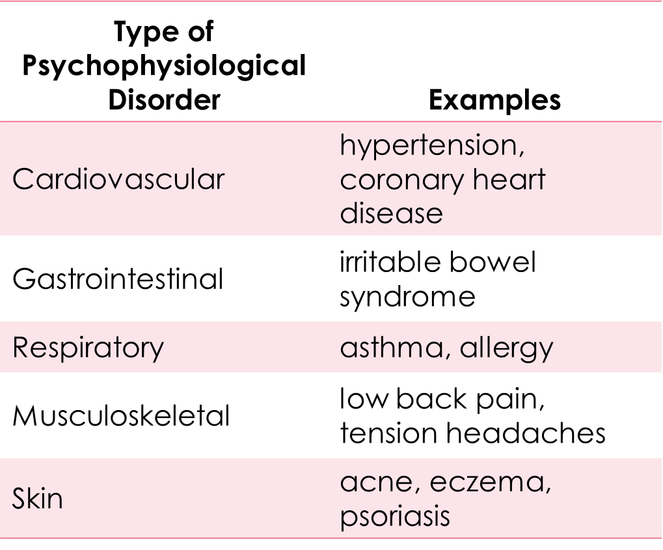
How Stress Impacts the Body
Notes:
Can even impact the likelihood of heart attacks

Slide 20
Stress and The Immune System
Immunosuppression
Autoimmune diseases
Psychoneuroimmunology
Lymphocytes
Lymphoma
Notes:
immunosuppression, the decreased effectiveness of the immune system.
An autoimmune disease occurs when the body's immune system mistakenly attacks its own healthy tissues and organs
Psychoneuroimmunology is the field that studies how psychological factors such as stress influence the immune system and immune functioning.
lymphocytes, white blood cells that circulate in the body’s fluids that are important in the immune response; hormones released by HPA axis inhibit the production of lymphocytes
Lymphoma – one of the most common cancers in young adults

Slide 21
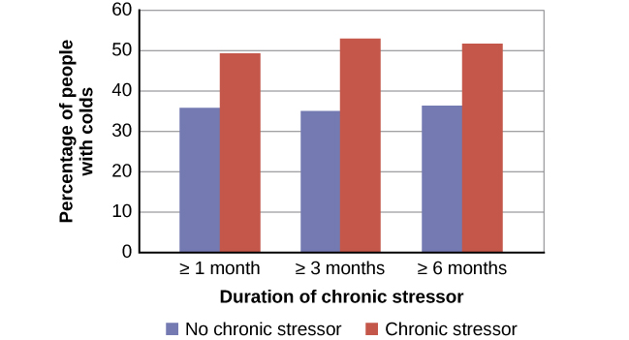
Stress and Common Colds

Slide 22
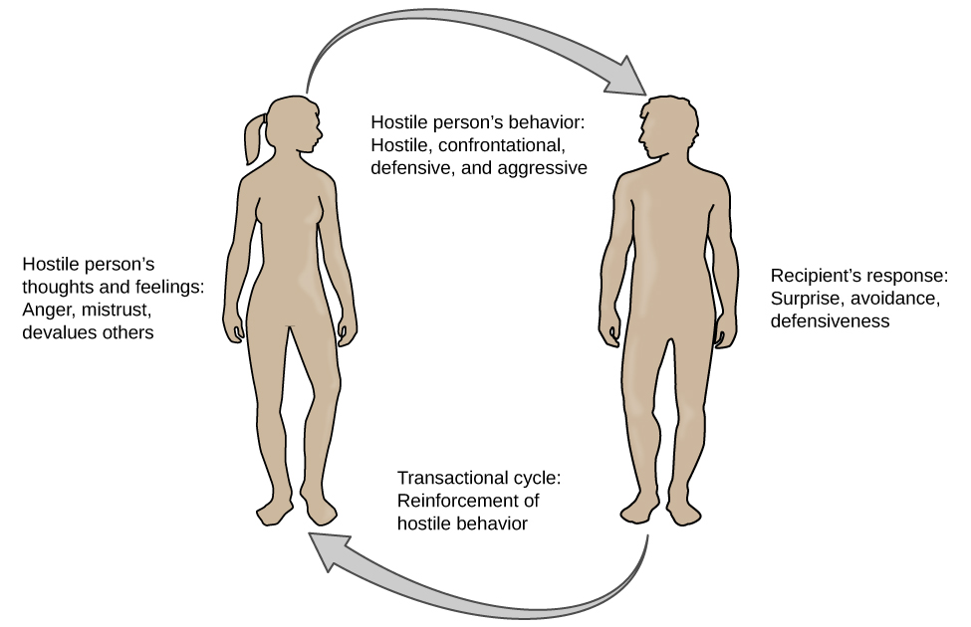
The Transactional Model of Hostility
Negative affectivity – is a tendency to experience distressed emotional states involving anger, contempt, disgust, guilt, fear, and nervousness
Notes:
Negative affectivity has been linked with the development of both hypertension and heart disease.

Slide 23
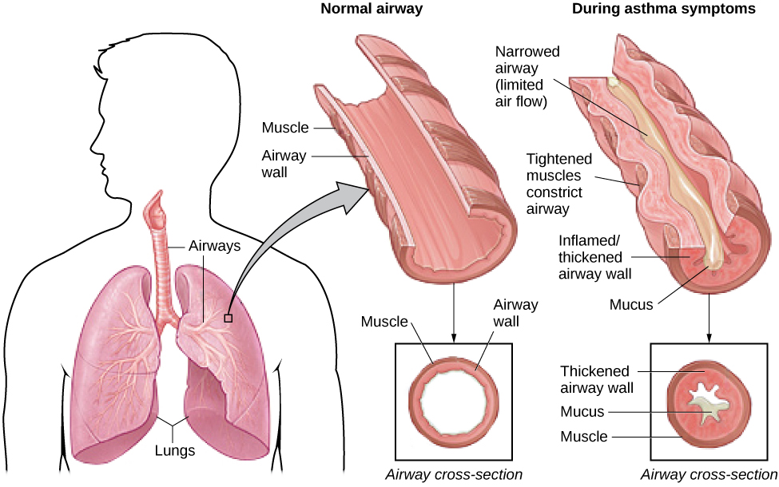
Asthma

Slide 24
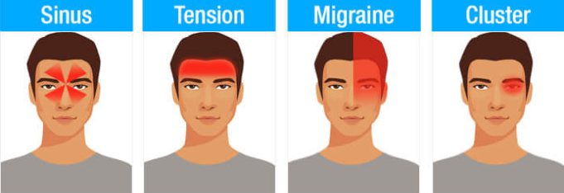
Headaches

Slide 25
The Regulation of STRESS

Slide 26
Coping Styles
Coping style – the approach a person typically utilizes when processing stress
How do you respond to a stressor?
Avoidance-oriented coping – a coping style where a person will push away stressor-related thoughts and feelings, deny the existence or seriousness of the stressor, or distract oneself
Approach-oriented coping – a coping style where a person makes an effort to solve the problem, seek support, and actively reframe the stressor towards the positive
Leads to better health outcomes
How do you cope with the stressor?
Problem-focused coping – attempting to do something constructive about the stressful conditions.
Emotion-focused coping – regulating emotions experienced because of the stressful event.

Slide 27
Handling Stress
Perceived control
Social support
Relaxation response techniques
Biofeedback
Notes:
Perceived control is our beliefs about our personal capacity to exert influence over and shape outcomes, and it has major implications for our health and happiness
Biofeedback is a technique that uses electronic equipment to accurately measure a person’s neuromuscular and autonomic activity—feedback is provided in the form of visual or auditory signals.
Relaxation techniques- square breathing; progressive muscle reaction; guided imagery; yoga

Slide 28
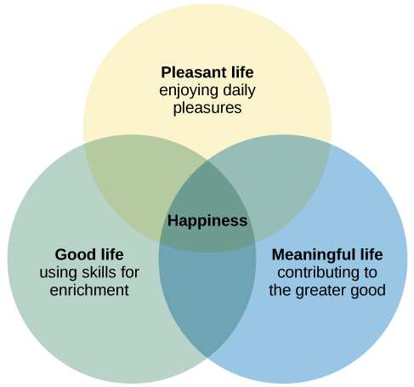
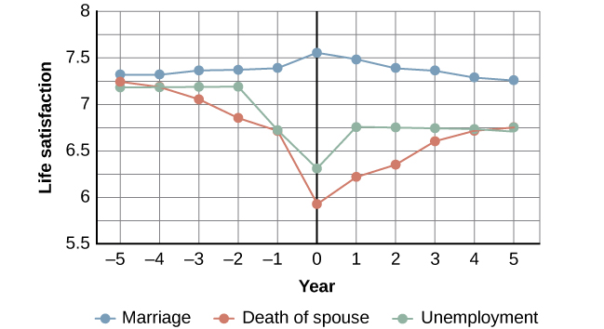
Positive Psychology: The Science of Happiness
Notes:
Graph: happiness before and after major life events

Slide 29
Class Activity
For today’s class activity, we will practice relaxation techniques
I will guide you three examples: square breathing, progressive muscle relaxation, and guided imagery
After we go through the examples, on the provided sheet of paper, write your name and your favorite technique
Be sure to turn in your answer before leaving

Slide 30
Next time on PSY 203…
BEFORE NEXT CLASS:
NEXT CLASS:
Complete Exam 3 Reflection
Due tonight!
Read Chapter 15 & take quiz
Chapter 15 – Psychological Disorders

